Slide 1
Web Development Basics
Presenting by Nishitha S
</> HTML,CSS,JAVASCRIPT & JQUERY </>

Slide 2
HTML
HyperText Markup Language

Slide 3
HOW WEBSITES/WEBPAGES WORKS?
Internet: A global network connecting computers.
Web page: Files sent from a server to your browser, shown as a webpage.
How it works: Your browser requests information, the server sends it, and your browser displays the page.
The Internet allows your browser to ask a server for information (like a webpage), and the server sends back the information, allowing you to view it. This process happens very quickly, so you can browse websites in real-time!
What is HTML?
• HTML(Hyper Text Markup Language) is a language for describing web pages.
not a programming language uses markup tags to describe web pages.
• Most Web documents are created using HTML. Documents are saved with extension .html or .htm.
Markup?
Markup Tags are strings in the language surrounded by a < and a > sign.
Opening tag: <html> Ending tag: </html>
Not case sensitive.
Can have attributes which provide additional information about HTML elements on your page.- <body bgcolor="red">

Slide 4
HTML BOILERPLATE
HEAD SECTION : <base>,<link>,<meta>,<title>,<style>,<script>
BODY SECTION: each doc should have utmost one <body> tag. Attr: bgcolor, background(image),text(color of a text)
HTML truncates spaces in your text.
Body tags - <br>,<p>,<div>,<span>(inline format of a text)
Formatting tags — <b>...</b> <i>...</i><u>...</u>,<strike> or <s>(deprecated in HTML5) ,<sub>,<sup>,<small>, <em>,<hr>(attr size,color, align),<font> (attr size,color)
<!DOCTYPE HTML> <html> <head> /* HEAD SECTION */ <title>Title of page</title> </head> <body> /* BODY SECTION */ This is my first HTML PAGE. <b>This text is bold</b> </body> </html>

Slide 5
ATTRIBUTES : these are special word which gives speciality to a tag
Comments in HTML DOC
Single line comment : /* */
Multi-line comment: <!-- -->
Headings
The heading tag start from <h1> to range <h6> where h1 is the largest and h6 is the least
Special characters in html
Syntax - Ampersand(&),
entity name or #,
Character code (i.e 62),
semicolon(;),
Ex- &copy;, &nsbp;, &#62;,&gt;

Slide 6
Links
Links are used to travel from one page to other or one section to another section by tag called anchor tag <a></a>
<a href="https://cdac.in">Example LINK</a>
IMAGES
To add images to the document by using <img> tag
<img src="image.jpg" alt="Description of image">
LISTS
Unordered list — <ul><li></li></ul>
Ordered list — <ol><li></li></ol>
Unorder list attr : type(deprecated and use as list-style-type) as disc, circle, square
Ordered list attr : type, start, reversed as 1, A, a,I,i

Slide 7
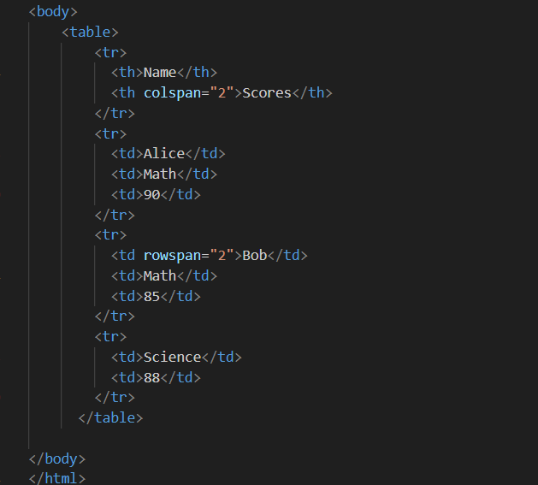
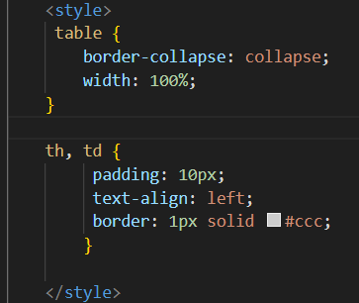
Tables
To add Tables to the webpage by using tag called <table> where include hyperlinks, images
Attr : rowspan, colspan, cellpadding, caption

Slide 8
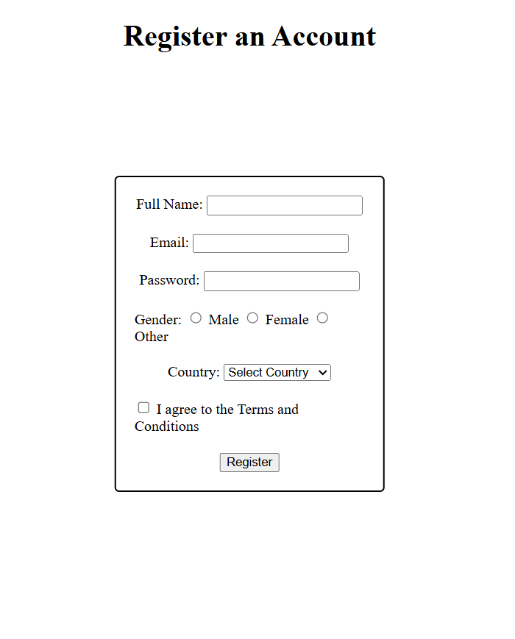
Forms
Forms are crucial for collecting user input
<form method=”post/get” action=”url”>
<label for=”forname”>
<input type=”typename” id=”” name=””>
<button type=”submit”></button
</form>
Type
text
password
radio
checkbox
file
submit/reset
button

Slide 9
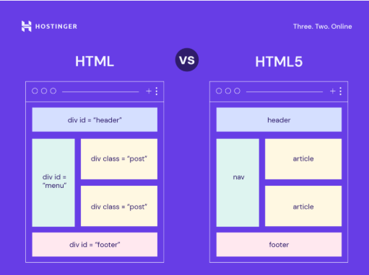
HTML 5

Slide 10
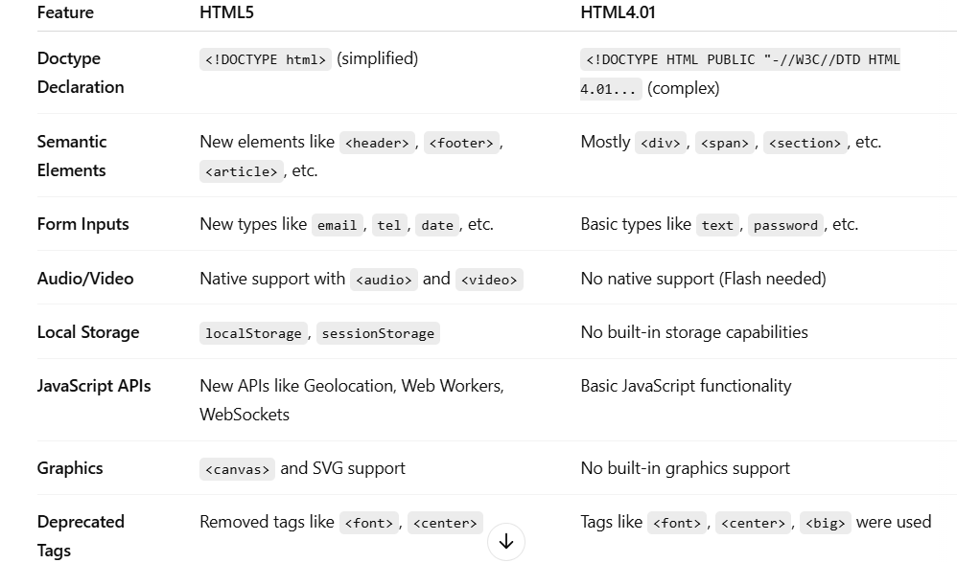
<strike>

Slide 11
CSS
Cascading Style Sheets

Slide 12
What is CSS?
CSS (Cascading Style Sheets) is a style sheet language used for describing the presentation of a document written in HTML. It controls layout, colors, fonts, and visual appearance.
Ways of adding styles
1. Inline CSS
<p style="color: blue; font-size: 16px;">This is a blue paragraph.</p>
2. Internal CSS (in the head section)
<head>
<style>
p {
color: blue;
font-size: 16px;
}
</style>
</head>

Slide 13
3. External CSS (separate file)
<head>
<link rel="stylesheet" href="styles.css">
</head>
SELECTORS
Universal Selector (*)
Type Selector(element name)
Class Selector(.)
ID Selector(#)
Attribute Selector([])
Descendant Selector(space)
Child Selector(>)
Adjacent Sibling Selector(+)
General Sibling Selector(~)
Pseudo-classes(:)
:hover, :first-child,:nth-child(position/ odd/even)

Slide 14
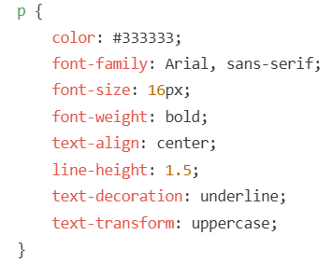
11. pseudo-elements(::)
::after, ::before, ::first-letter,::last-line
p::first-letter {
font-size: 2em; /* Makes the first letter of <p> larger */
}
p::before {
content: ">> "; /* Adds ">> " before every <p> */
}
12. Grouping selector(,)
BASIC CSS PROPERTIES
Text styling

Slide 15
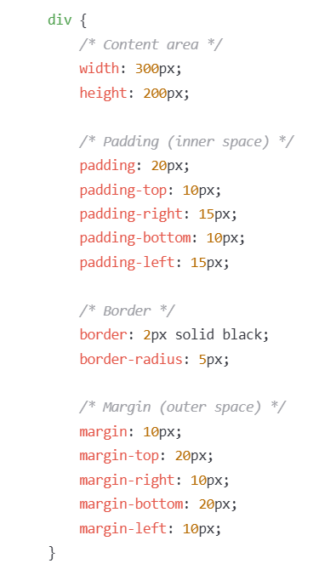
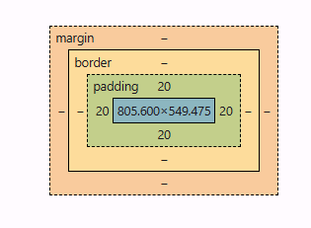
BOX MODEL

Slide 16
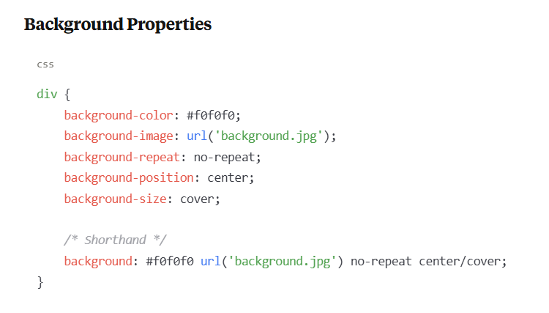

Slide 17
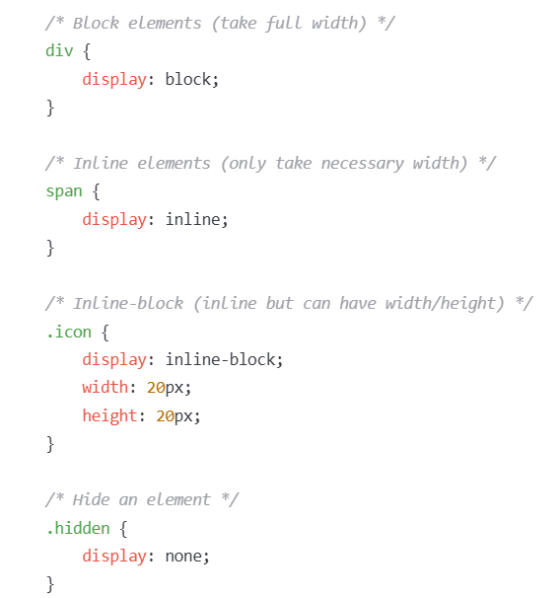
DISPLAY PROPERTIES

Slide 18
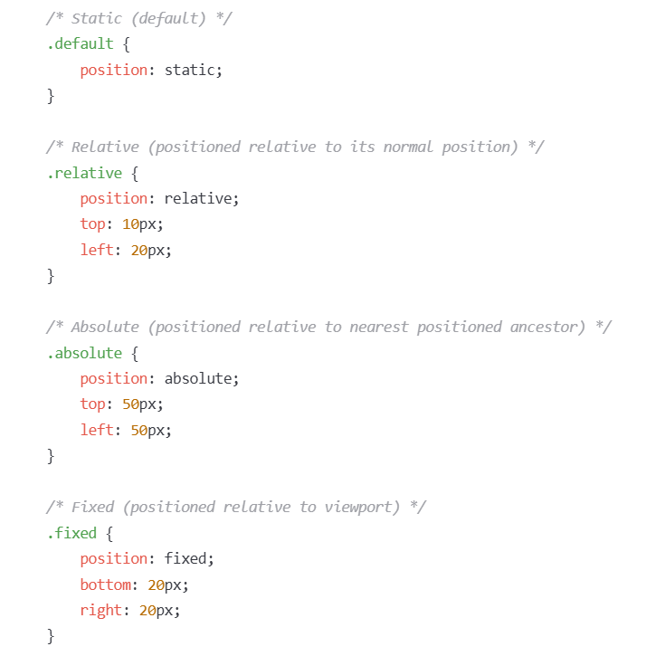
POSITIONING PROPERTIES

Slide 19
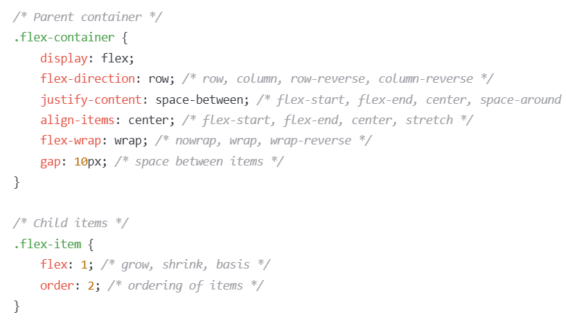
FLEXBOX BASICS

Slide 20
JAVASCRIPT
JS

Slide 21
What is JavaScript?
JavaScript is a programming language that enables interactive web pages. It's an essential part of web applications and adds behavior to your HTML/CSS structure.
How to Include JavaScript
1. Internal JavaScript
2. External JavaScript
<script>
// JavaScript code here
console.log("Hello, World!");
</script>
<script src="script.js"></script>

Slide 22
JavaScript Basics
Variables and Data Types
// Variables
let name = "John"; // String
const age = 25; // Number - constant (cannot be reassigned)
var isStudent = true; // Boolean - older way to declare variables
// Data Types
let fullName = "John Doe"; // String
let userAge = 30; // Number
let price = 99.99; // Number (decimal)
let isActive = false; // Boolean
let userInfo = null; // Null
let undefinedVar; // Undefined
let person = { // Object
name: "John",
age: 30
};
let colors = ["red", "green", "blue"]; // Array

Slide 23
Output and Debugging
// Console output (for debugging)
console.log("Hello, World!");
console.log(name, age, isStudent);
// Alert (user notification)
alert("Welcome to our website!");
// Prompt (get user input)
let userName = prompt("Please enter your name:");
console.log("Hello, " + userName);

Slide 24
Operators
// Arithmetic operators
let sum = 5 + 10; // Addition
let difference = 10 - 5; // Subtraction
let product = 5 * 10; // Multiplication
let quotient = 10 / 5; // Division
let remainder = 10 % 3; // Modulus (remainder)
let exponent = 2 ** 3; // Exponentiation (2^3)
// Assignment operators
let x = 10;
x += 5; // x = x + 5
x -= 3; // x = x - 3
x *= 2; // x = x * 2
x /= 4; // x = x / 4
// Comparison operators
let isEqual = 5 == "5"; // Equal to (value only)
let isStrictEqual = 5 === 5; // Strict equal to (value and type)
let isNotEqual = 5 != 10; // Not equal to
let isGreater = 10 > 5; // Greater than
let isLess = 5 < 10; // Less than
let isGreaterOrEqual = 10 >= 10; // Greater than or equal to
let isLessOrEqual = 5 <= 10; // Less than or equal to

Slide 25
Control Flow - Conditional Statements
// Logical operators
let logicalAnd = (5 > 3) && (10 > 5); // AND
let logicalOr = (5 > 10) || (10 > 5); // OR
let logicalNot = !(5 > 10); // NOT
// If statement
if (age >= 18) {
console.log("You are an adult.");
}
// If-else statement
if (age >= 18) {
console.log("You are an adult.");
} else {
console.log("You are a minor.");
}
// Ternary operator (shorthand for simple if-else)
let message = (age >= 18) ? "You can vote" : "Too young to vote";

Slide 26
// If-else if-else statement
if (age < 13) {
console.log("Child");
} else if (age < 20) {
console.log("Teenager");
} else {
console.log("Adult");
}
// Switch statement
let day = 3;
switch (day) {
case 1:
console.log("Monday");
break;
case 2:
console.log("Tuesday");
break;
case 3:
console.log("Wednesday");
break;
default:
console.log("Another day");
}

Slide 27
Loops
// For loop
for (let i = 0; i < 5; i++) {
console.log("Count: " + i);
}
// While loop
let count = 0;
while (count < 5) {
console.log("Count: " + count);
count++;
}
// Do-while loop (executes at least once)
let num = 0;
do {
console.log("Number: " + num);
num++;
} while (num < 5);
// For...of loop (for arrays)
const fruits = ["apple", "banana", "orange"];
for (const fruit of fruits) {
console.log(fruit);
}

Slide 28
Functions
// For...in loop (for objects)
const person = {
name: "John",
age: 30,
city: "New York"
};
for (const key in person) {
console.log(key + ": " + person[key]);
}
// Basic function
function greet(name) {
return "Hello, " + name + "!";
}
// Calling a function
let greeting = greet("John");
console.log(greeting); // "Hello, John!"
// Function with default parameters
function welcome(name = "Guest") {
return "Welcome, " + name + "!";}

Slide 29
console.log(welcome()); // "Welcome, Guest!"
console.log(welcome("Jane")); // "Welcome, Jane!"
// Functions as variables (function expressions)
const add = function(a, b) {
return a + b;
};
console.log(add(5, 3)); // 8
// Arrow functions (ES6+)
const multiply = (a, b) => a * b;
console.log(multiply(4, 2)); // 8
// Arrow function with block
const square = (x) => {
const result = x * x;
return result;
};
console.log(square(5)); // 25

Slide 30
Working with Arrays and Objects - Arrays
// Creating arrays
let colors = ["red", "green", "blue"];
let numbers = [1, 2, 3, 4, 5];
let mixed = [42, "hello", true, null, {name: "John"}];
// Accessing array elements
console.log(colors[0]); // "red"
console.log(colors[2]); // "blue"
// Modifying arrays
colors[1] = "yellow"; // Changes "green" to "yellow"
colors.push("purple"); // Adds element to the end
colors.pop(); // Removes last element
colors.unshift("black"); // Adds element to the beginning
colors.shift(); // Removes first element
// Array properties and methods
console.log(colors.length); // Number of elements
console.log(colors.includes("red")); // true
console.log(colors.indexOf("yellow")); // 1
console.log(colors.join(", ")); // "red, yellow, blue"

Slide 31
Working with Arrays and Objects - Objects
Objects
// Array iteration
colors.forEach(function(color) {
console.log(color);
});
// Map, filter, reduce (ES6+)
const doubled = numbers.map(num => num * 2);
const evens = numbers.filter(num => num % 2 === 0);
const sum = numbers.reduce((total, num) => total + num, 0);
// Creating objects
const person = {
firstName: "John",
lastName: "Doe",
age: 30,
email: "john@example.com",
address: {
city: "New York",
country: "USA"
},
hobbies: ["reading", "swimming"],
greet: function() {
return "Hi, I'm " + this.firstName;
}};

Slide 32
// Accessing object properties
console.log(person.firstName); // "John"
console.log(person["lastName"]); // "Doe"
console.log(person.address.city); // "New York"
console.log(person.hobbies[0]); // "reading"
console.log(person.greet()); // "Hi, I'm John"
// Modifying objects
person.firstName = "Jane";
person["age"] = 28;
person.address.city = "Boston";
person.hobbies.push("painting");
// Adding new properties
person.isEmployed = true;
person.skills = ["HTML", "CSS", "JavaScript"];
// Object methods
console.log(Object.keys(person)); // Array of property names
console.log(Object.values(person)); // Array of property values
// Object destructuring (ES6+)
const { firstName, lastName, age } = person;
console.log(firstName); // "Jane"

Slide 33
DOM manipulation
Accessing DOM Elements
// By ID
const header = document.getElementById("header");
// By class name
const items = document.getElementsByClassName("item"); // HTMLCollection
// By tag name
const paragraphs = document.getElementsByTagName("p"); // HTMLCollection
// Query selector (first match)
const firstButton = document.querySelector("button");
const navLink = document.querySelector(".nav-link");
// Query selector all (all matches)
const buttons = document.querySelectorAll("button"); // NodeList
const navLinks = document.querySelectorAll(".nav-link"); // NodeList

Slide 34
Modifying DOM Elements
// Changing content
element.textContent = "New text content"; // Just text
element.innerHTML = "<strong>HTML content</strong>"; // Can include HTML
// Changing attributes
element.setAttribute("href", "https://example.com");
element.id = "newId";
element.className = "new-class";
// Working with styles
element.style.color = "blue";
element.style.fontSize = "18px";
element.style.display = "none";

Slide 35
Creating and Modifying DOM Elements
// Create new element
const newParagraph = document.createElement("p");
newParagraph.textContent = "This is a new paragraph.";
// Append element to parent
document.body.appendChild(newParagraph);
// Insert before another element
const referenceElement = document.getElementById("existingElement");
document.body.insertBefore(newParagraph, referenceElement);
// Remove element
element.parentNode.removeChild(element);
// Or more modern way:
element.remove();

Slide 36
Event handling
Adding Event Listeners
// Basic syntax
element.addEventListener("event", function);
// Common events
button.addEventListener("click", function(event) {
console.log("Button clicked!");
event.preventDefault(); // Prevent default behavior
});
document.getElementById("myForm").addEventListener("submit", function(event) {
event.preventDefault(); // Prevent form submission
console.log("Form submitted");
});

Slide 37
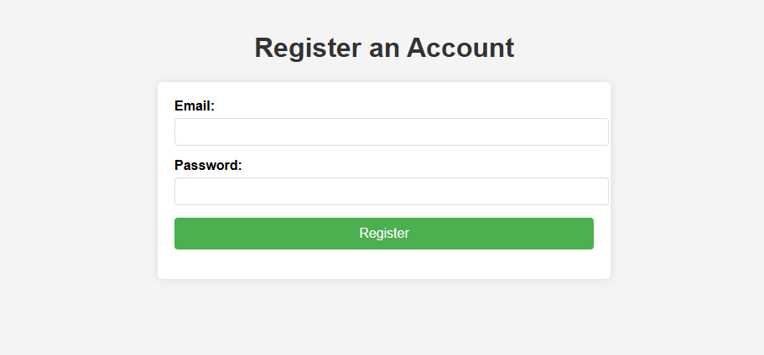

Slide 38
JQUERY
Javascript library

Slide 39
What is jQuery?
jQuery is a fast, small, and feature-rich JavaScript library that simplifies HTML document traversing, event handling, animating, and Ajax interactions for rapid web development.
jQuery library can be included in a document by linking to a local copy or to one of the
versions available from public servers repository which is also called as Content delivery network(CDN’s)
Basic Syntax
$(selector).action();

Slide 40
Common Selectors
// Select by element
$("p").css("color", "blue");
// Select by ID
$("#header").text("New Header");
// Select by class
$(".item").hide();
// Combined selectors
$("ul.menu li").addClass("active");
// Multiple selectors
$("h1, h2, h3").css("font-family", "Arial");
// Attribute selectors
$("input[type='text']").val("Default text");
$("a[href^='https']").addClass("external");

Slide 41
DOM Traversal
// Filtering selections
$("li").first().css("font-weight", "bold");
$("li").last().css("color", "red");
$("li").eq(2).css("background-color", "yellow"); // 3rd element (zero-based index)
// Finding elements
$("ul").find("li").addClass("list-item");
$("div").children("p").css("font-style", "italic");
$("li").parent().css("border", "1px solid black");
// Siblings
$("h1").next().css("margin-top", "0");
$("h1").siblings("p").css("color", "gray");

Slide 42
DOM Manipulation with jQuery
Getting and Setting Content
// Text content
const text = $("#element").text(); // Get text
$("#element").text("New text"); // Set text
// HTML content
const html = $("#element").html(); // Get HTML content
$("#element").html("<strong>New</strong> content"); // Set HTML content
// Form values
const value = $("#inputField").val(); // Get input value
$("#inputField").val("New value"); // Set input value
// Attributes
const href = $("a").attr("href"); // Get attribute
$("a").attr("href", "https://new-url.com"); // Set attribute
$("a").removeAttr("target"); // Remove attribute

Slide 43
CSS and Classes
// Adding/removing classes
$("p").addClass("highlight");
$("p").removeClass("old-class");
$("p").toggleClass("active");
$("p").hasClass("highlight"); // returns true/false
// CSS properties
$("div").css("color", "blue");
$("div").css({
"color": "blue",
"font-size": "18px",
"padding": "10px"
});
// Getting CSS value
const color = $("div").css("color");

Slide 44
Event Handling with jQuery
// Click event
$("#button").click(function() {
alert("Button clicked!");
});
// Common events
$("#element").mouseenter(function() {
$(this).addClass("hover");
});
$("#element").mouseleave(function() {
$(this).removeClass("hover");
});
$("#textInput").focus(function() {
$(this).css("border-color", "blue");
});
$("#textInput").blur(function() {
$(this).css("border-color", "gray");
});
$("#myForm").submit(function(event) {
event.preventDefault(); // Prevent form submission
console.log("Form submitted");});

Slide 45
Thank you

